Slide 1
Assignment 02 Web Mario
Software Studio 軟體設計與實驗
Hung-Kuo Chu
Department of Computer Science
National Tsing Hua University
CS2410

Slide 2
Goal
Complete a “Mario style game” by Cocos Creator.
You can use the materials TAs provide or download needed materials from some open source webpages to beautify the appearance.
Deploy your web game to Firebase page, and ensure it works correctly.
Report which items you have done (items in scoring page) and describing other functions or feature in REABME.md.

Slide 3
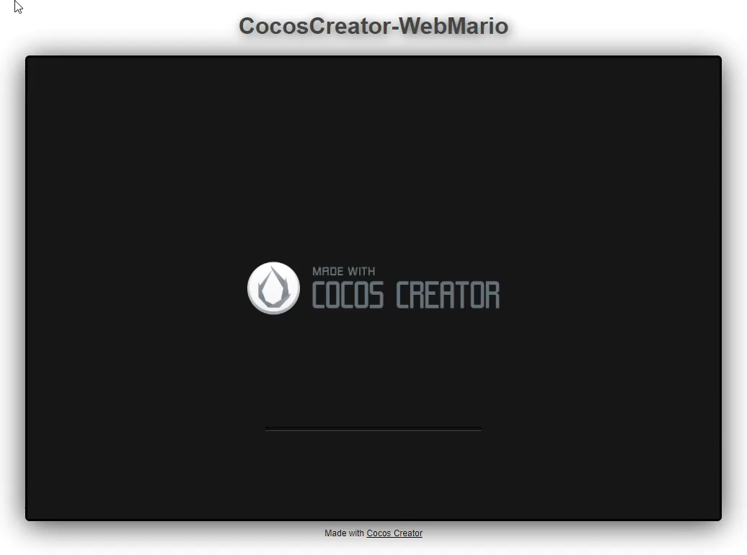
Mario
Example result

Slide 4
Scoring
Membership Mechanism (10%)
Sign up (5%)
Log in (5%)
You need to use Firebase to record users information (e.g., life, score…) instead of storing at localhost
Complete Game Process (5%)
Start menu
Level select
Game view(including game start / game over)
You need to control the game process according to current game & player status

Slide 5
Scoring
Basic Rules (45%)
World Map: (5%)
The world must have correct physics properties, Ex: objects fall due to gravity, two different objects should collide with each other correctly, etc.
Background & Camera should move according to the player’s position.
At least two different world maps.
Level Design: (5%)
The scene should have “Static” wall
The scene should include question blocks which can interact with the player

Slide 6
Scoring
Basic Rules (45%)
Player: (15%)
Player should have correct physics properties.
User can control the player to move and jump by keyboard.
When player touches enemies or be attacked by enemies, it will get hurt or the number of its life will decrease.
When player get out of the bounds, the number of its life will decrease.
When player dies, it can reborn at the initial position.

Slide 7
Scoring
Basic Rules (45%)
Enemies: (15%)
Enemies should have correct physics properties.
At least two different types of enemies.
There must be significant difference between different types of enemies.
Only when player hits on their heads can kill them.
Question Blocks: (5%)
At least two different types of blocks.
Blocks can interact with player correctly.

Slide 8
Scoring
Animations (10%)
Player has walk & jump animations (5%)
Enemies Animation (each for 2%, up to 5%)
Sound Effects (10%)
At least one BGM (2%)
Player Jump & die sound effects (3%)
Additional sound effects (each for 1%, up to 5%)
All sound effects can’t stop BGM
UI (10%)
Player life(the number of life must be able to read & write on firebase) (3%)
Player score(the score must be able to read & write on firebase) (5%)
Timer (2%)
Appearance(subjective) (5%)

Slide 9
Scoring
Bonus (At most 15%)
Leaderboard (5%)
Multi-player game
Set up another backend server for online version (15%)
Offline version (5%)
Others?

Slide 10
Scoring
Item | Score
Membership Mechanism | 10%
Complete Game Process | 5%
Basic Rules | 45%
Animations | 10%
Sound Effects | 10%
UI | 10%
Appearance (subjective) | 5%
Bonus (describe on README.md) | 15%
Total score is at most 110

Slide 11
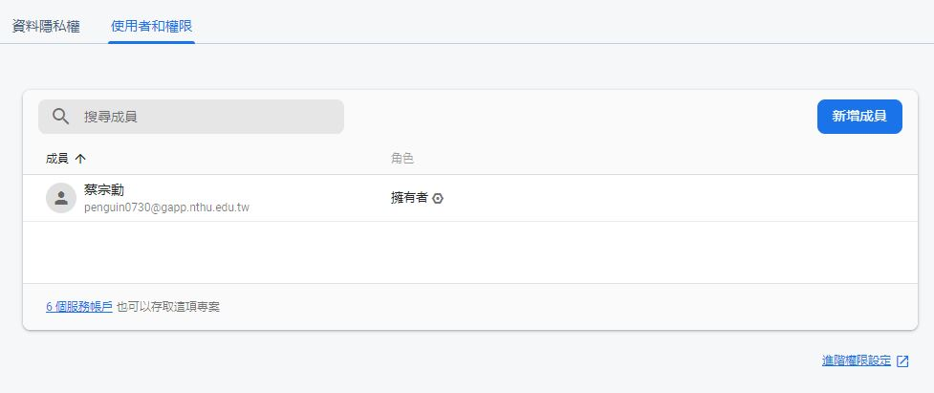
Add permission to TA’s account
Go project setting and select “Users and permissions”

Slide 12
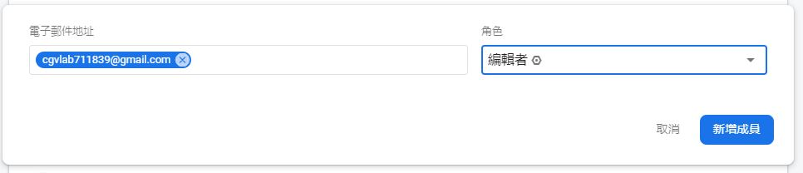
Add permission to TA’s account
Add cgvlab711839@gmail.com as editor to your project.

Slide 13
Reminder
Deploy your web page to Firebase page, and ensure it works correctly.
Please add TA’s account to your Firebase project
Upload all source code to FTP.
.html or .css, .js, .ts, etc.
source files
README.md
Zip all files into Assignment02_學號.zip
(Ex: Assignment02_109062000.zip)
FIRM deadline: 2022/05/22 23:59 (commit time)
MD5 checksum (if you didn’t do this → -10%)
You will be graded ZERO under one of the following conditions
Missing the deadline, no matter what kind of reasons you have…
Plagiarism (抄襲), both the plagiarist (抄襲者) and accomplice (被抄襲者) will be graded zero.
Crashed program (e.g., 404 - Not Found)
Not upload the source files to FTP
Not add TA’s account to your Firebase project

Slide 14
作業繳交規則
請務必透過 MD5 獲得作業checksum 後填入 google 表單。
如遇各種原因無法在作業期限前完成上傳，我們將比對 checksum。若 checksum 一致則不算遲交。
繳交作業以MD5為主，若有多個 checksum 則取時間最晚的為主。
MD5 online generator
MD5 checksum 登記表單
MD5 checksum 登記查看
MD5 使用方法

Slide 15
作業繳交流程
請務必遵守以下規則：
將作業打包壓成zip檔，檔名格式以及打包內容以當次作業公告為主。
幫zip檔產生MD5，並填寫google表單。
將zip檔上傳ftp。
將MD5和網址繳交至eeclass。
若違反任何一項繳交作業SOP，
一律扣作業總分10分！！！
貼心提醒：請同學守護zip檔至作業成績公告或期末。
Notes:
2021 新增作業繳交流程

